Slide 1

Midterm Election Simulation Project
Group 2
Erica Nam, Xiao Xu, Xinyu Zhang, Yitao Li

Slide 2
Data Simulation
For each of nrep replications:
We first generate N_contam the size of the contaminating group using a bin(N, q). q is our assumption for the percentage of the contaminating group out of the entire sample which has a sample size N. N - N_contam is the size of the sample that is not contaminated. Note that when q = 0, there is no contamination in the sample.
Second, we generate the number of people in the contaminating group who prefer candidate 1 (N_true₁), candidate 2 (N_true₂) and candidate 3 (N_true₃) respectively using a multinomial (N_contam, p₁, p₂, p₃) since the proportion of people in this group favors candidate 1, candidate 2 and candidate 3 is p₁, p₂, p₃.
We also generate the number of people in the not contaminated group who prefer candidate 1 (N_contam₁), candidate 2 (N_contam₂) and candidate 3 (N_contam₃) respectively using a multinomial (N - N_contam, r₁, r₂, r₃) since the proportion of people in this group favors candidate 1, candidate 2 and candidate 3 is r₁, r₂, r₃.
Then we have the simulated number of people who prefer candidate 1 N₁ = N_true₁ + N_contam₁. People who prefer candidate 2 N₂ = N_true₂ + N_contam₂. People who prefer candidate 3 N₃ = N_true₃ + N_contam₃.

Slide 3
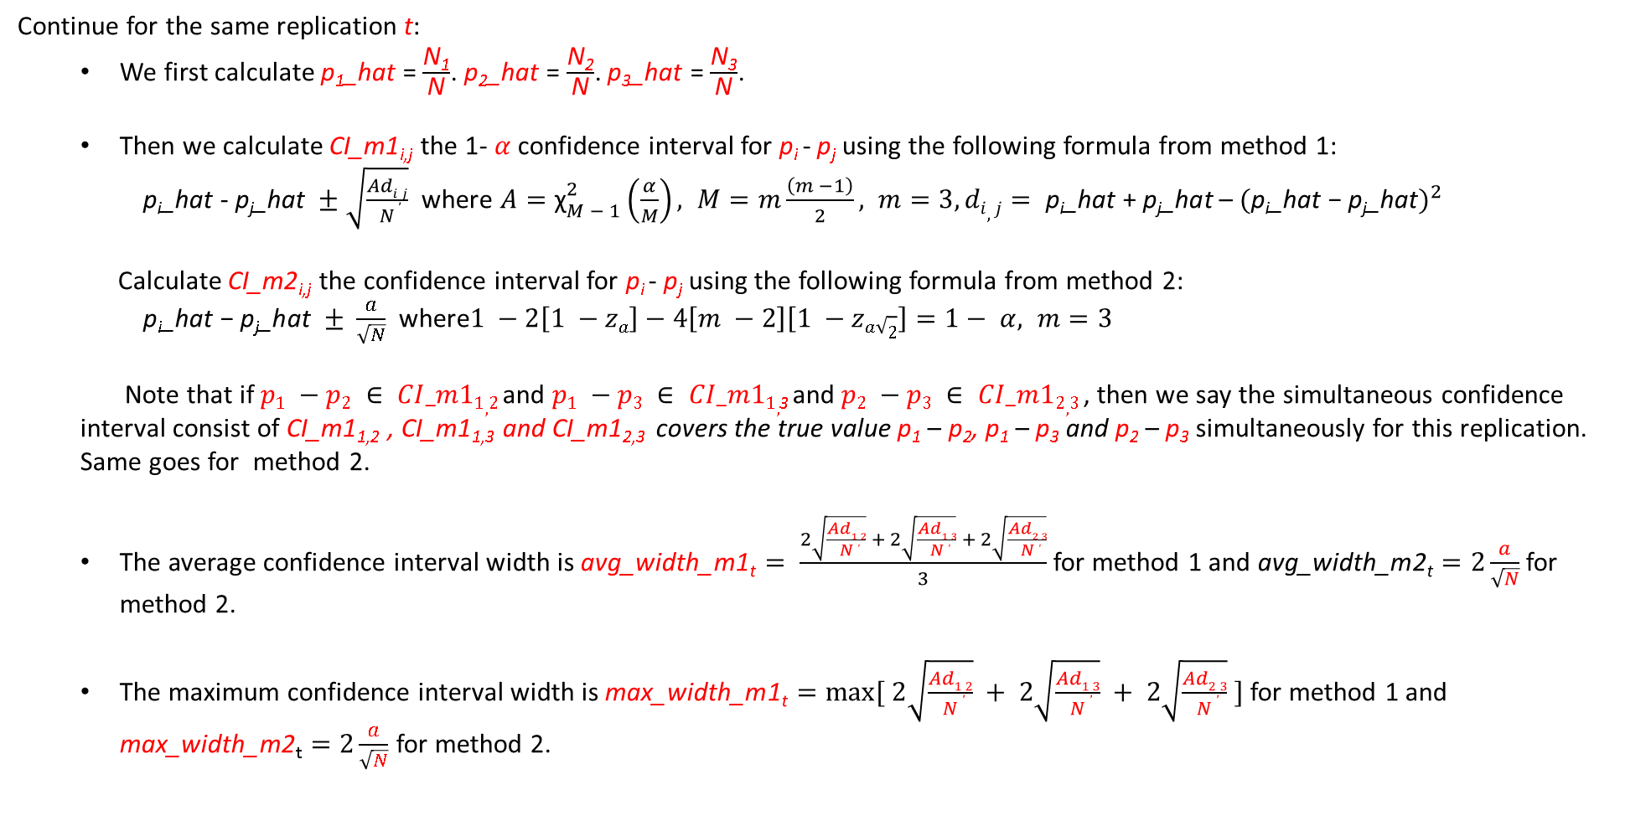
Confidence Interval
Continue for the same replication t:
We first calculate p₁_hat = $\frac{\text{N}\text{1}}{\text{N}}$. p₂_hat = $\frac{\text{N}\text{2}}{\text{N}}$. p₃_hat = $\frac{\text{N}\text{3}}{\text{N}}$.
Then we calculate CI_m1_{i,j} the 1- $α$confidence interval for p_{i} - p_{j} using the following formula from method 1:
$\text{p}\text{i}\text{_}\text{hat} \text{- }\text{p}\text{j}\text{_}\text{hat} ±\sqrt{\frac{Adi,j}{N}}$ where ${A=\text{χ}}_{M − 1}^{2}\left(\frac{α}{M}\right), M=m\frac{\left(m −1\right)}{2}, m=3, di,j= \text{p}\text{i}\text{_}\text{hat} \text{+} \text{p}\text{j}\text{_}\text{hat}$ – ${\text{(}\text{p}\text{i}\text{_}\text{hat}\text{ − }\text{p}\text{j}\text{_}\text{hat})}^{2}$
Calculate CI_m2_{i,j} the confidence interval for p_{i} - p_{j} using the following formula from method 2:
$\text{p}\text{i}\text{_}\text{hat}\text{ − }\text{p}\text{j}\text{_}\text{hat} ± \frac{a}{\sqrt{N}}$ where$1 −2\left[1 −za\right]−4\left[m −2\right]\left[1 −za\sqrt{2}\right]=1− α, m=3$
Note that if $p1 −p2 ∈ CI_m11,2$ and $p1 −p3 ∈ CI_m11,$₃ and $p2 −p3 ∈ CI_m12,3$ , then we say the simultaneous confidence interval consist of CI_m1_{1,2} , CI_m1_{1,3} and CI_m1_{2,3} covers the true value p₁ – p₂, p₁ – p₃ and p₂ – p₃ simultaneously for this replication. Same goes for method 2.
The average confidence interval width is $\text{avg}\text{_}\text{width}\text{_}\text{m}\text{1}\text{t}= \frac{2\sqrt{\frac{Ad1,2}{N}} + 2\sqrt{\frac{Ad1,3}{N}} + 2\sqrt{\frac{Ad2,3}{N}}}{3}$ for method 1 and $\text{avg}\text{_}\text{width}\text{_}\text{m}\text{2}\text{t}=2\frac{a}{\sqrt{N}}$ for method 2.
The maximum confidence interval width is $\text{m}\text{ax}\text{_}\text{width}\text{_}\text{m}\text{1}\text{t}=max⁡[ 2\sqrt{\frac{Ad1,2}{N}} + 2\sqrt{\frac{Ad1,3}{N}} + 2\sqrt{\frac{Ad2,3}{N}} ]$ for method 1 and $\text{m}\text{ax}\text{_}\text{width}\text{_}\text{m}\text{2}\text{t}=2\frac{a}{\sqrt{N}}$ for method 2.

Slide 4
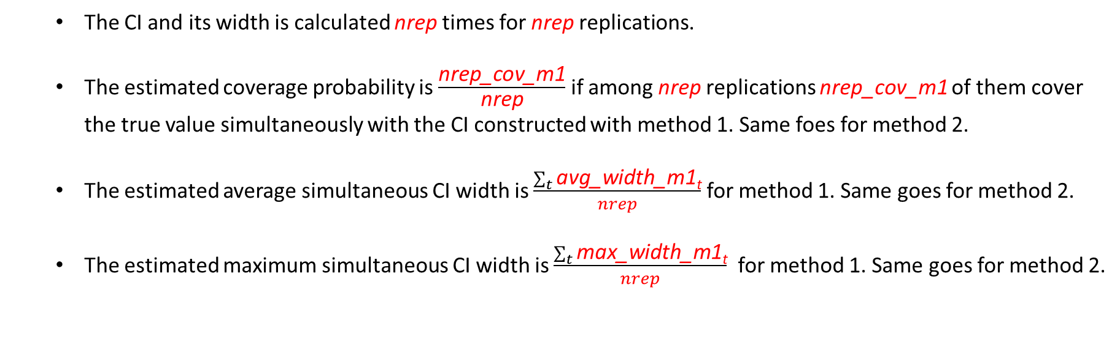
Simultaneous IC coverage probability and width
The CI and its width is calculated nrep times for nrep replications.
The estimated coverage probability is $\frac{\text{nrep}\text{_}\text{cov}\text{_}\text{m}\text{1}}{\text{nrep}}$ if among nrep replications nrep_cov_m1 of them cover the true value simultaneously with the CI constructed with method 1. Same foes for method 2.
The estimated average simultaneous CI width is $\frac{\sum_{t}{\text{avg}\text{_}\text{width}\text{_}\text{m}\text{1}\text{t}}}{nrep}$ for method 1. Same goes for method 2.
The estimated maximum simultaneous CI width is $\frac{\sum_{t}{\text{max}\text{_}\text{width}\text{_}\text{m}\text{1}\text{t}}}{nrep}$ for method 1. Same goes for method 2.

Slide 5
Insert d3 js plot here

Slide 6
Insert more d3 js plot here

Slide 7
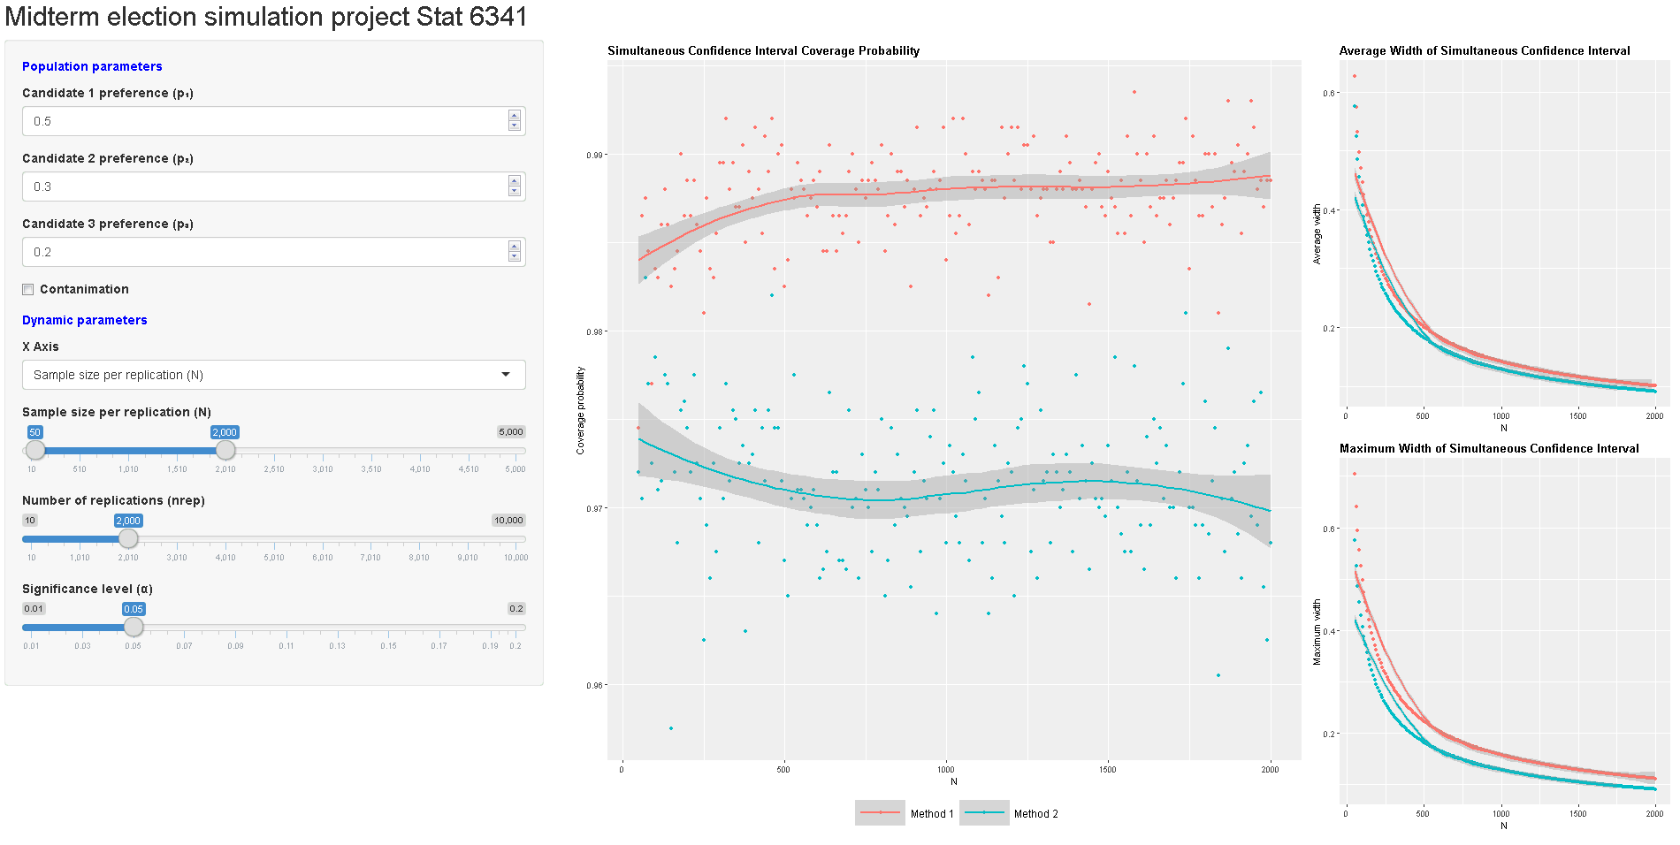
Shiny app interactive plot
When there is no contamination, method 1 is better than method 2 but with wider CI.
CI width decreases as N increase.

Slide 8
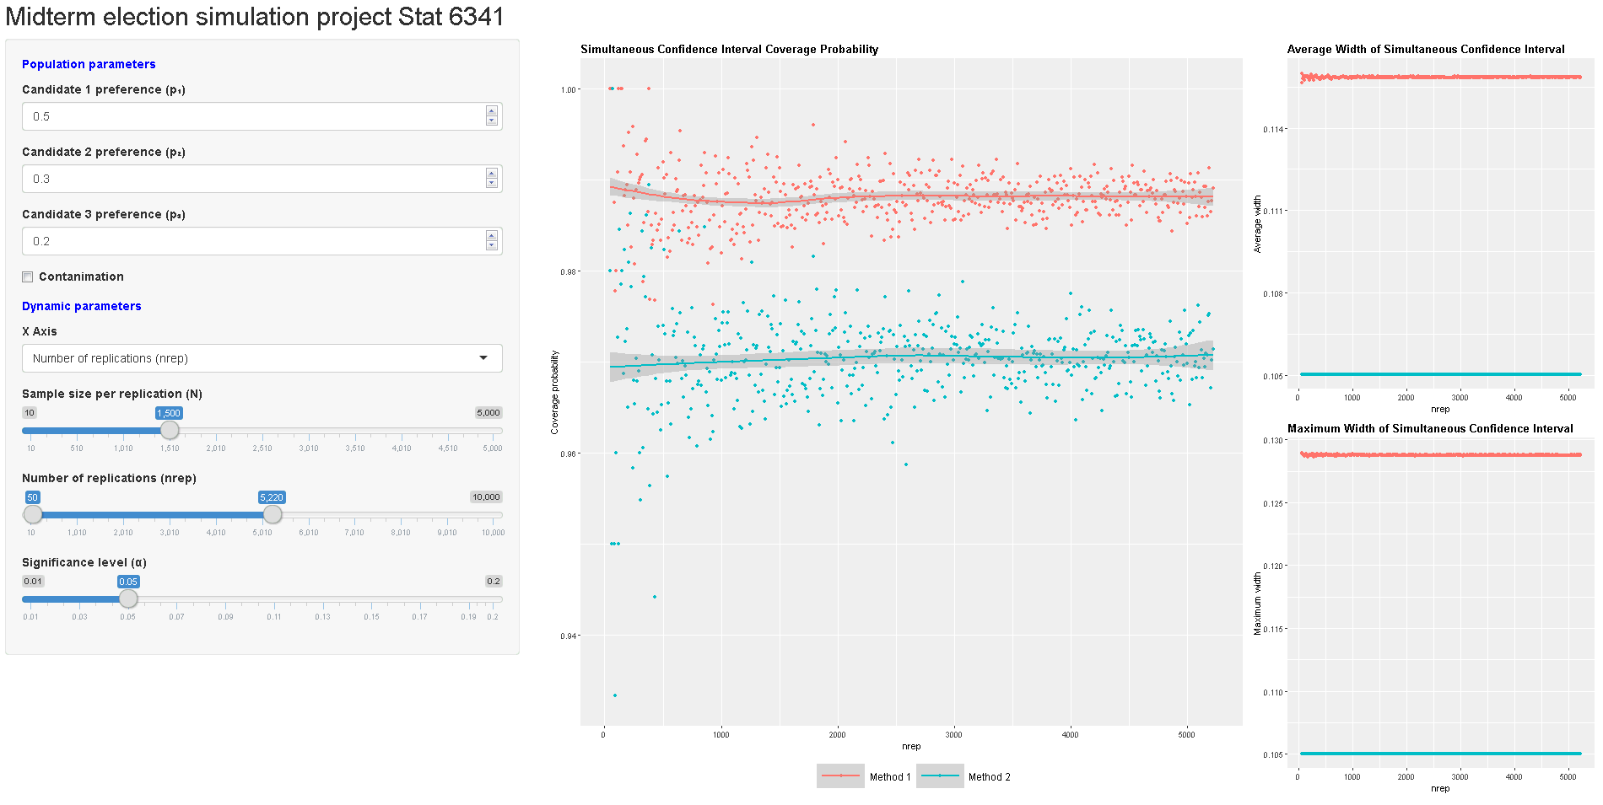
Shiny app interactive plot
The variance of the coverage probability decreases as nrep increase.

Slide 9
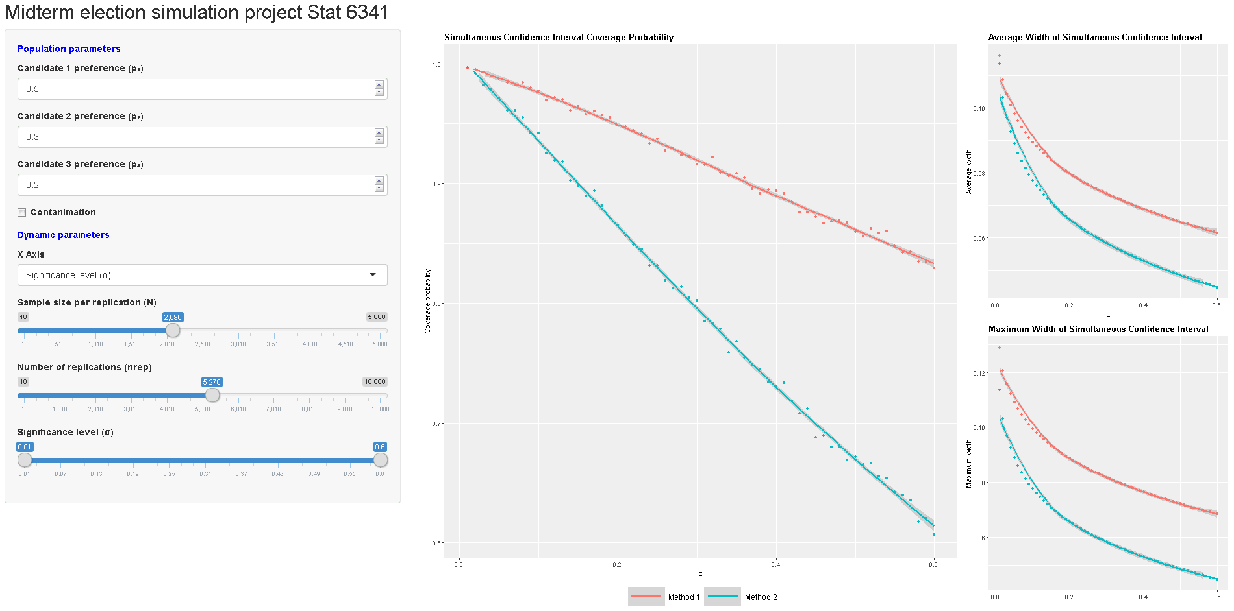
Shiny app interactive plot
The coverage probability decreases as α increase.
The coverage probability for Method 2 drops faster than Method 1. This could be explained by Method 2’s narrower CI width and faster deacreasing CI width.

Slide 10
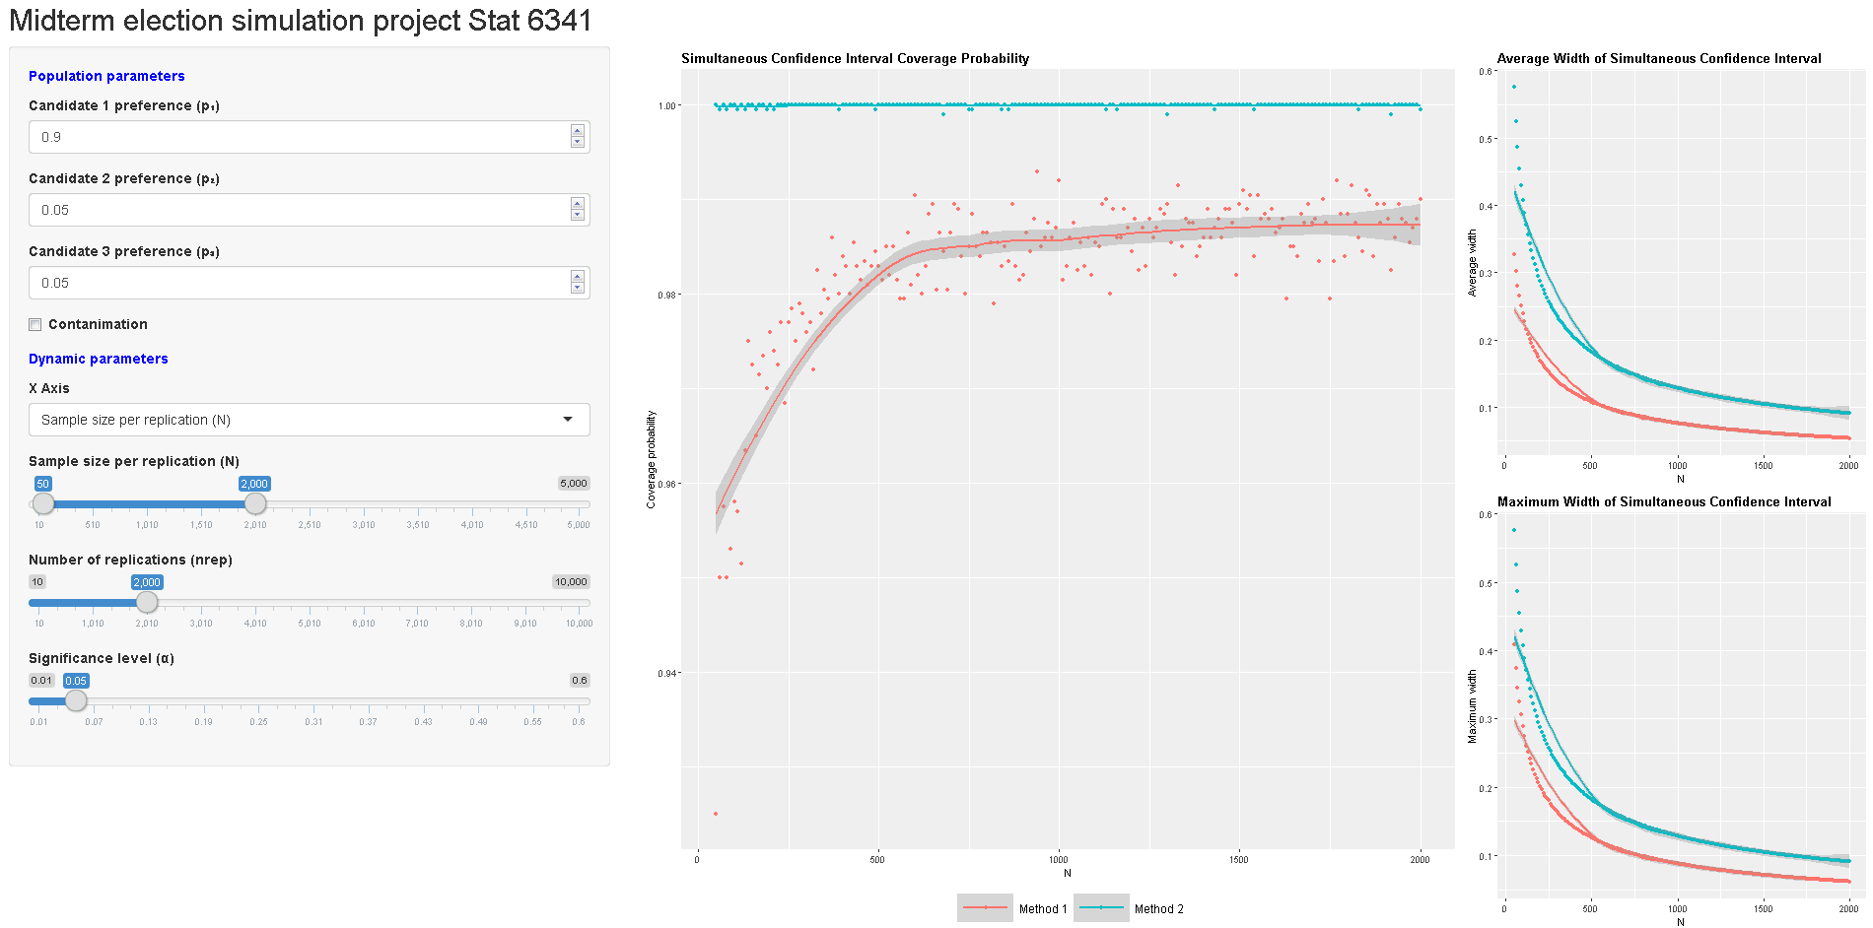
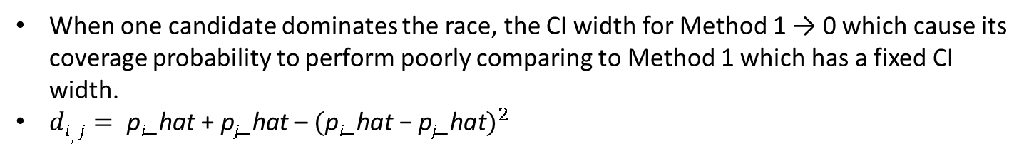
Shiny app interactive plot
When one candidate dominates the race, the CI width for Method 1 → 0 which cause its coverage probability to perform poorly comparing to Method 1 which has a fixed CI width.
$di,j= \text{p}\text{i}\text{_}\text{hat} \text{+} \text{p}\text{j}\text{_}\text{hat}$ – ${\text{(}\text{p}\text{i}\text{_}\text{hat}\text{ − }\text{p}\text{j}\text{_}\text{hat})}^{2}$

Slide 11
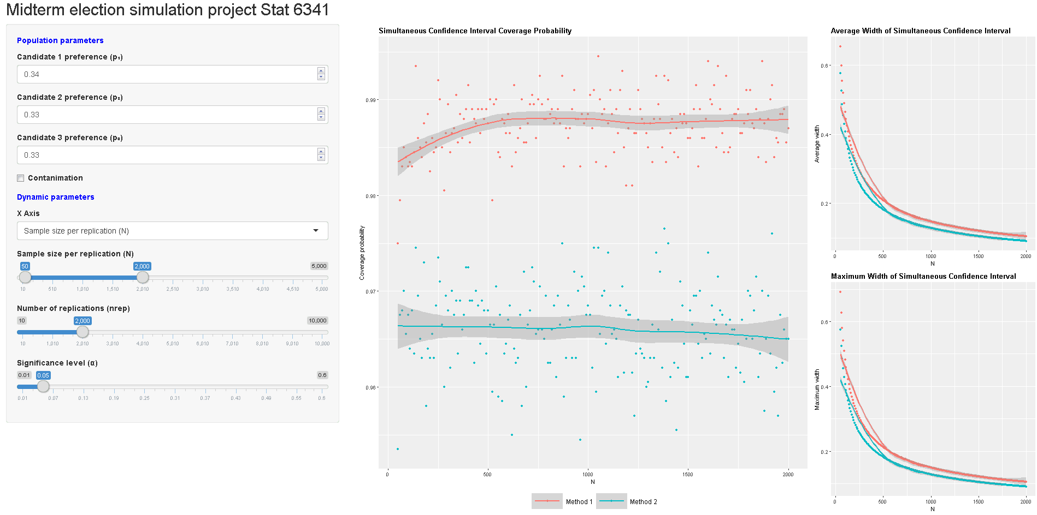
Shiny app interactive plot
When all three candidates are very close.

Slide 12
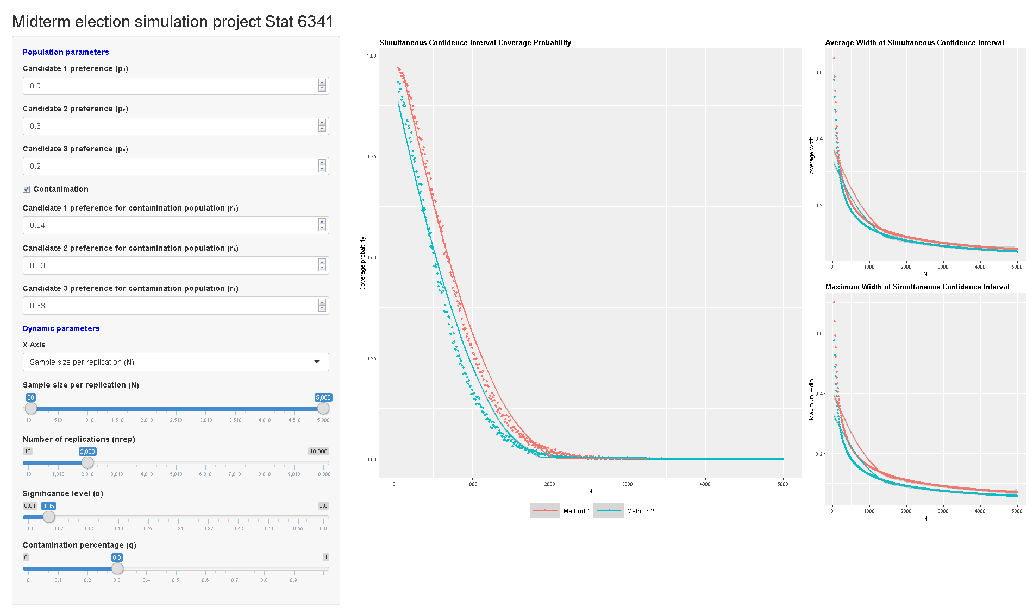
Shiny app interactive plot
When there is contamination, the CI width was wide enough at the beginning to achieve 90%+ coverage probability.

Slide 13
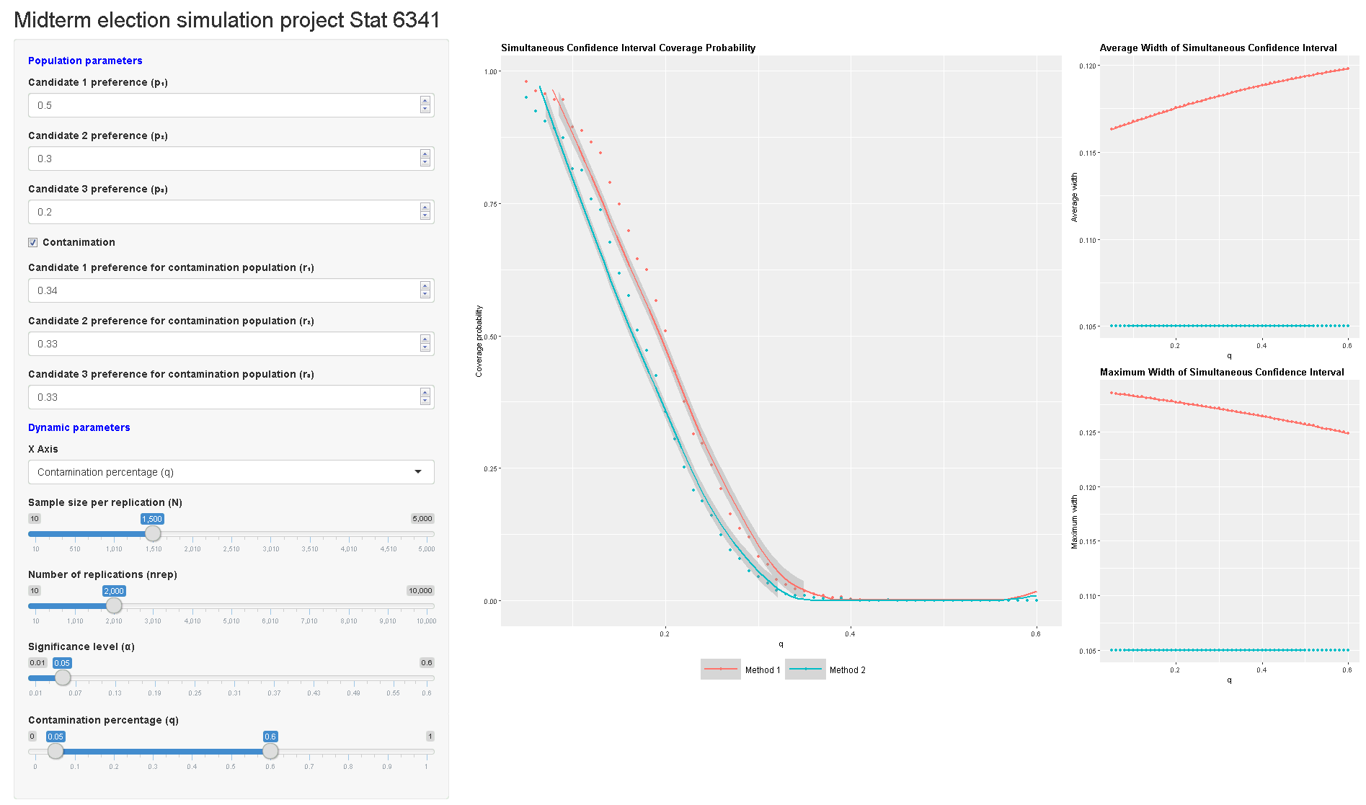
Shiny app interactive plot
When there is contamination, the coverage probability drops as contamination proportion increases.

Slide 14
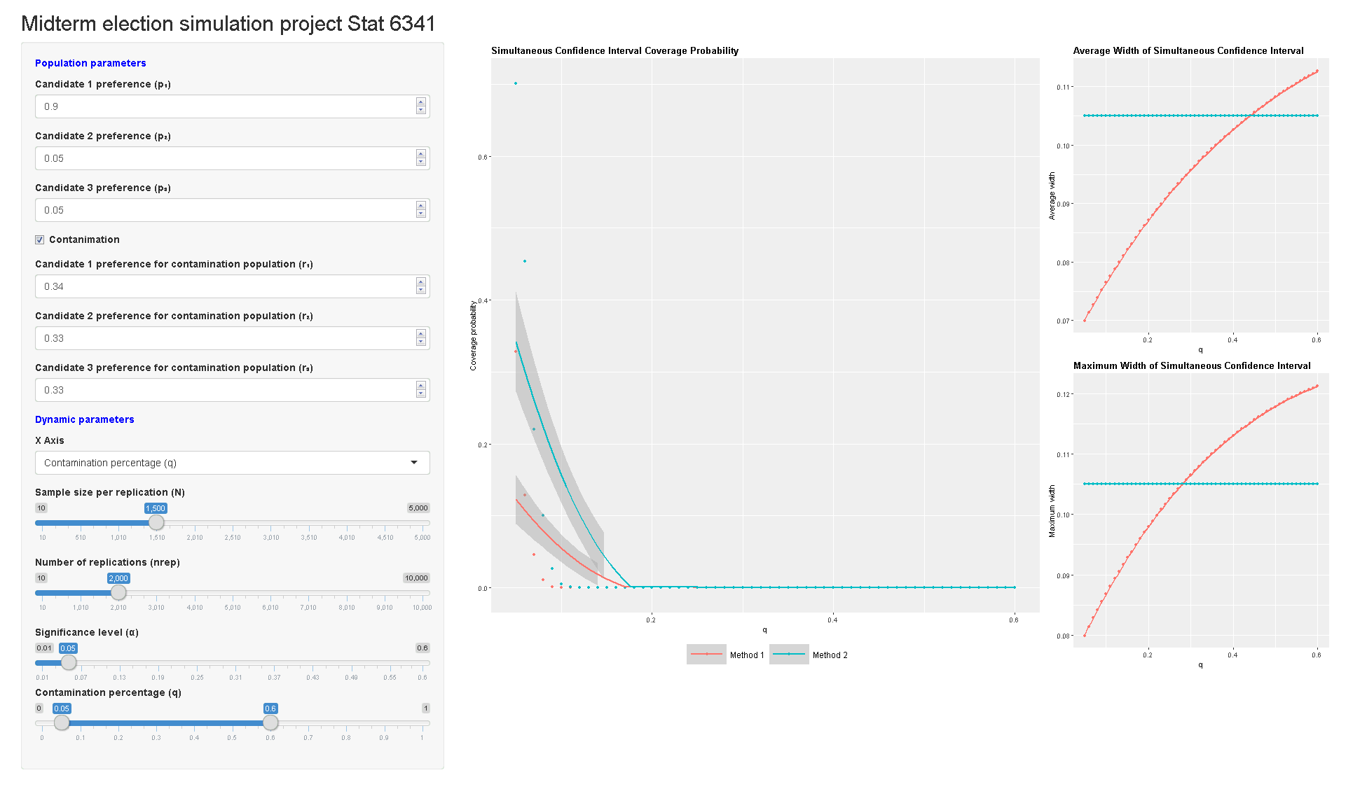
Shiny app interactive plot
When single domination is contaminated with close preference, the CI width for method 1 is smaller than Method 2 as expected.
As the sample gets more contaminated, the CI center shifts towards the contaminating group’s preference probability (close preference) which has a larger CI.

Slide 15
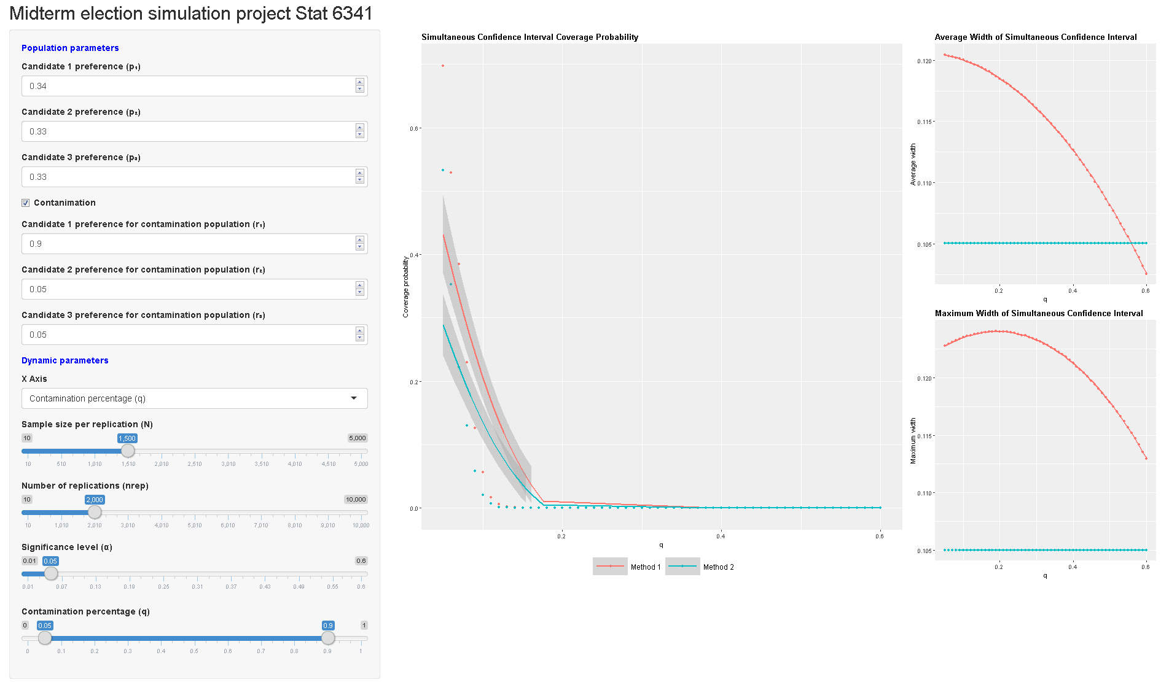
Shiny app interactive plot
In close preference contaminated with single domination setting, as the sample gets more contaminated the CI center shifts towards the contaminating group’s preference probability (single domination) which has a larger CI.
Even the overall trend of maximum CI with is decreasing, it actually goes up a little bit as the mixed p₁, p₂, p₃ becomes a little bit different.

Slide 16
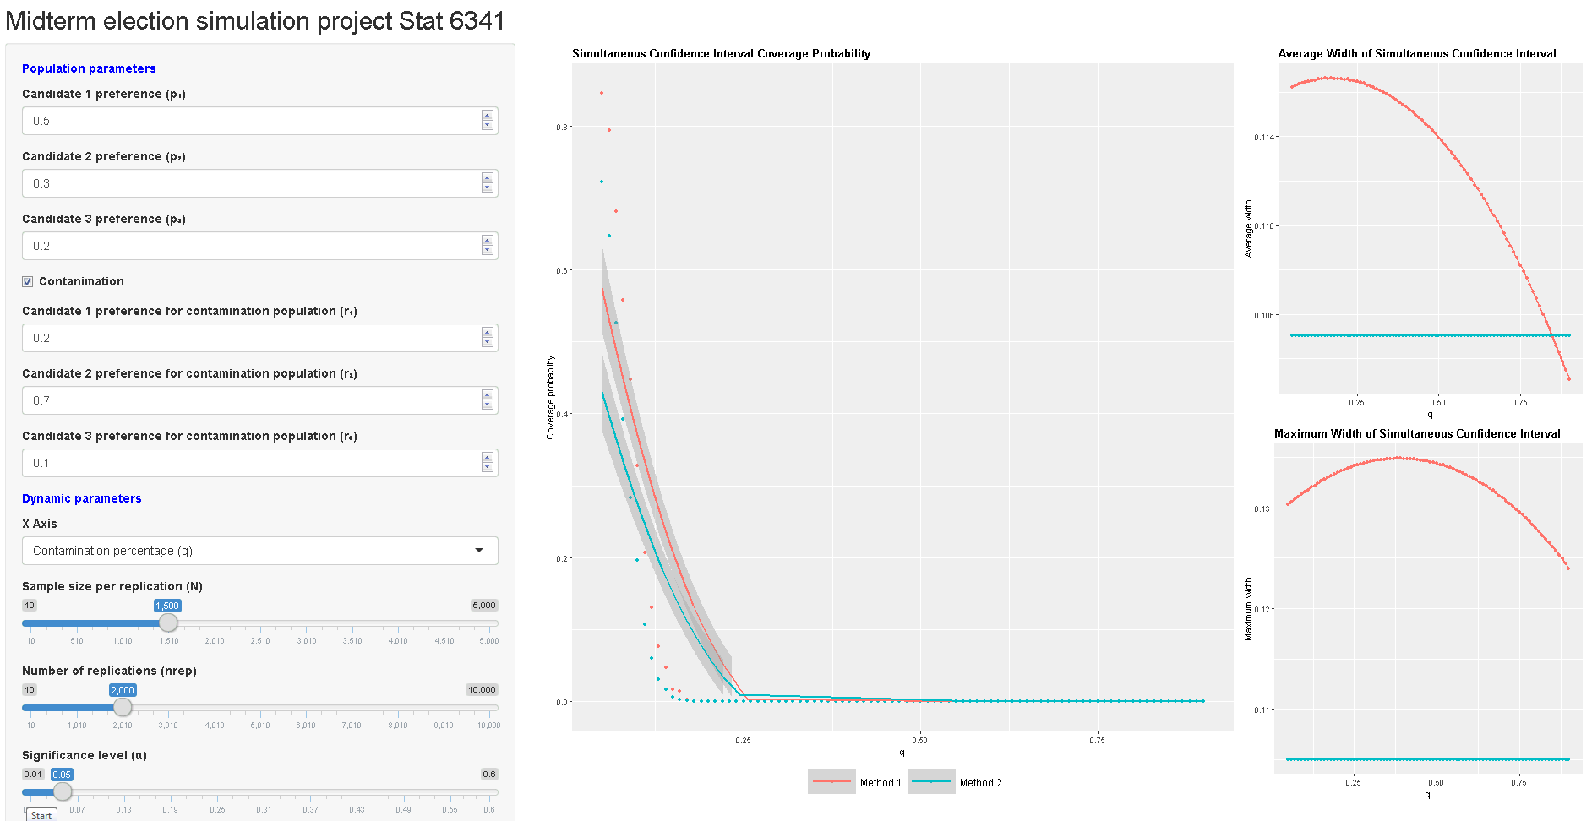
Shiny app interactive plot
Compare p₁, p₂, p₃ mixed with r₁, r₂, r₃ and p₁, p₂, p₃ mixed with r₁, r₃, r₂.
Coverage probability becomes 0 at q = 0.25 and average CI width has a small ascent right after mixing.

Slide 17
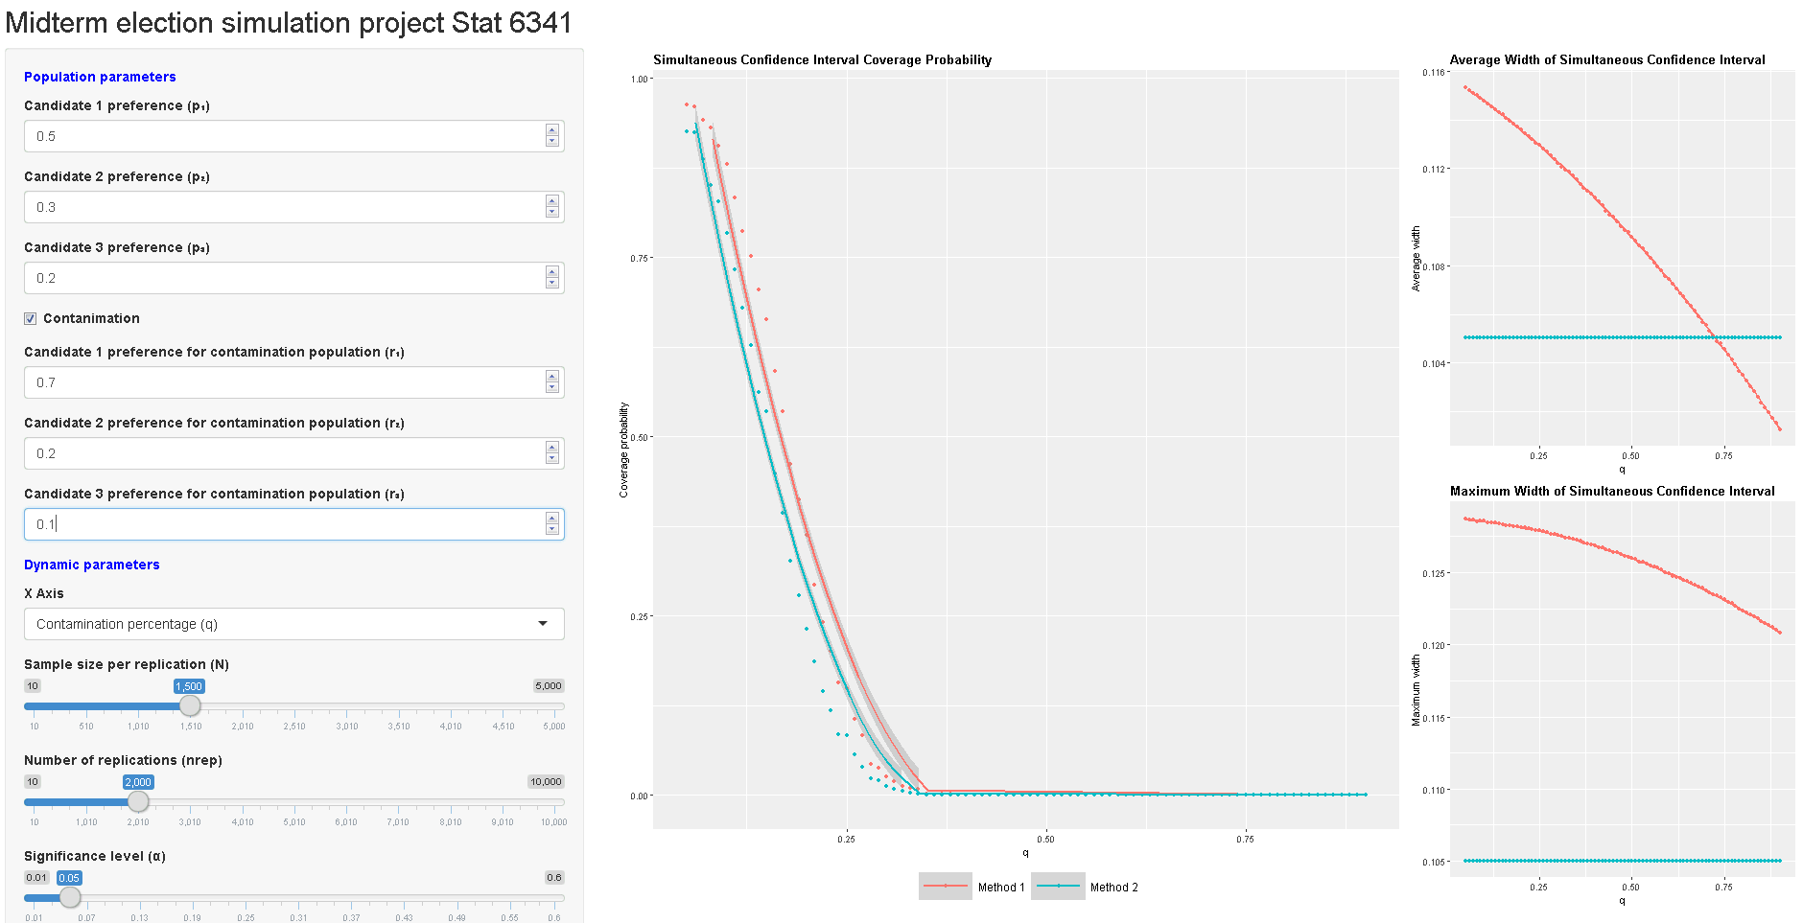
Compare p₁, p₂, p₃ mixed with r₁, r₂, r₃ and p₁, p₂, p₃ mixed with r₁, r₃, r₂.
Coverage probability becomes 0 at q =0.35.

Slide 18
Shiny app interactive plot
Compare p₁, p₂, p₃ mixed with r₁, r₂, r₃ and p₁, p₂, p₃ mixed with r₁, r₃, r₂.
Coverage probability becomes 0 at q = 0.25 and average CI width has a small ascent right after mixing.

Slide 19
Shiny app:
https://zxynj.shinyapps.io/Midterm_election_simulation_project_Stat_6341/

